Slide 1












Presented by Paul Robin at EmiLI conference
23/09/2026
From manure to tailored fertilizers: A generic model to predict gaseous emissions during composting
Robin Pourcel^{*1}, Paul Robin², Laurent Thuriès¹, Michaël Mathot³, Christiane Rakotomalala¹, Alexandre Mertens³
1 French Agricultural Research Center for International Development (CIRAD), France
2 National Institute of Agricultural Research (INRAE), France
3 Walloon Agricultural Research Center (CRA-W), Belgium
* robin.pourcel@cirad.fr
References

Slide 2




Introduction
For a given farm system, what is the impact of manure storage practices on greenhouse gas emissions and on solid manure stability?
Storage emissions
Stabilisation
Field emissions
Complete composting
+++
+++
0
Direct application
0
---
+++
Short storage
?
?
?
Complete composting
Short storage
Direct application
(Chadwick et al. 2011)
Notes:
Main question: For a given farm system, what is the impact of manure storage practices on greenhouse gases emissions? ​
To answer this, we need to model emissions from both manure storage/composting and field application. ​
Why ? ​
Consider two archetypes: ​
Long-term composting: high emissions during storage, but the organic matter become very stable, so we end up with relatively low emissions after field application. ​
No storage: negligible storage emissions, but this time the organic matter is labile, which leads to potentially high emissions after direct field application of fresh manure. ​
But most farms are somewhere in between: manure is stored for an arbitrary period and applied partially composted. Storage therefore affects the manure composition and its subsequent emissions in the field. ​
​

Slide 3
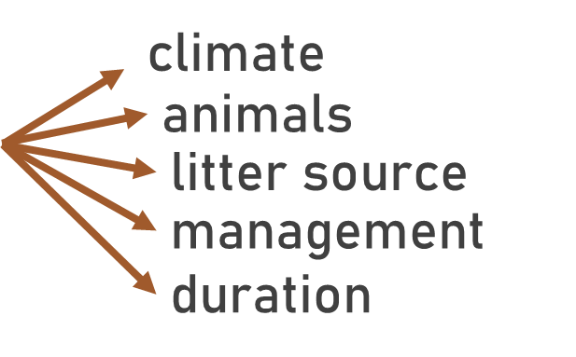
Part I: generic composting model
For a given farm system, what is the impact of manure storage practices on greenhouse gas emissions and on solid manure stability?
→ A generic composting model to address a range of various situations
→ A generic composting model to address a range of various situations
→ A way to transfer the outputs of the composting model into an existing soil–crop application/degradation model
Notes:
Duration of the maturation is the first factor impacting the properties of the manure, but on top of that there are multiple cofactor to take into account.
To estimate emissions across diverse farm systems, we need: ​
A flexible composting model able to account for a wide diversity of manure characteristics and storage durations. ​
A way to transfer the outputs of the composting model into an existing soil–crop application/degradation model, so that storage effects are propagated to field emissions. ​

Slide 4
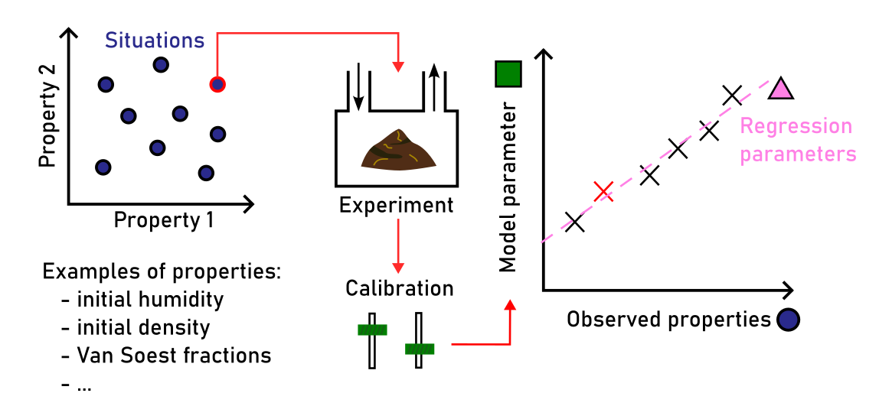
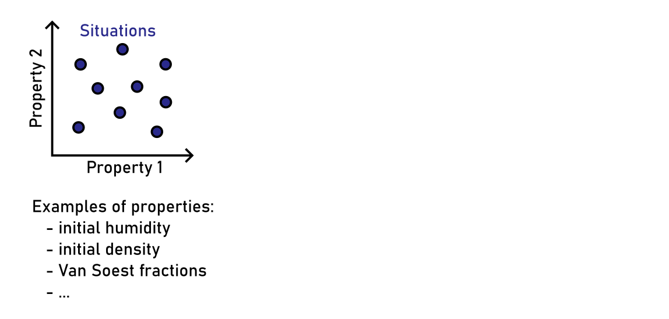
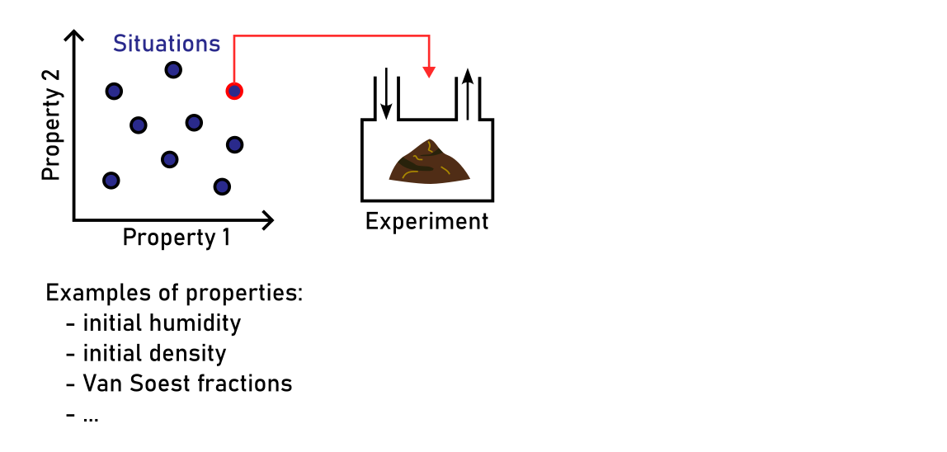
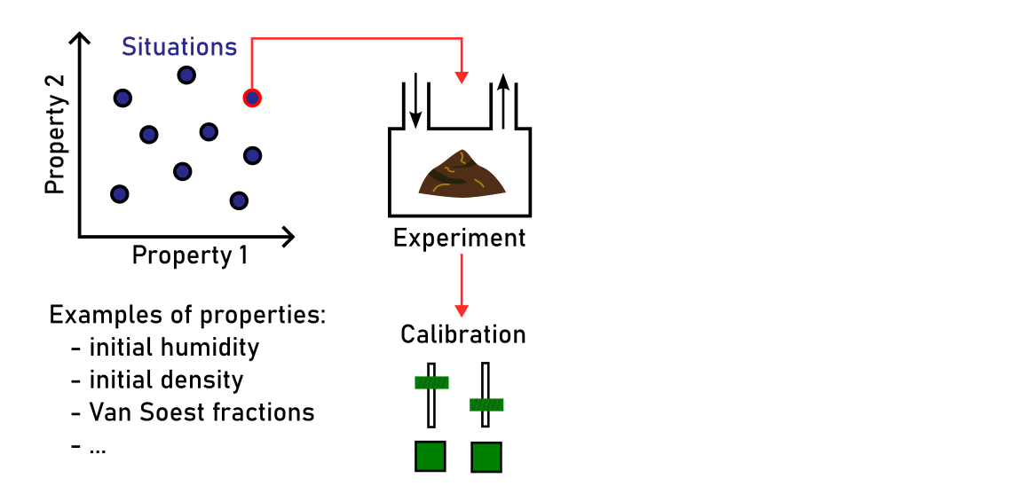
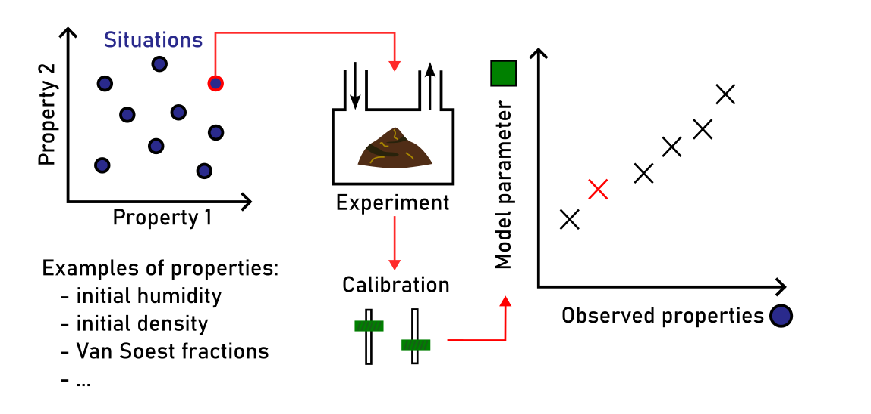
Generic composting model
Method
(Robin et al. 2019; D. Oudart et al. 2015; Didier Oudart 2013)
Notes:
How to acheive genericity
We developped our own model called MEGASMOC and represents the dynamics of CO2, NH3, CH4 and N2O for static pile composting.
It’s a mechanistic model based on physic assumptions but some parameters needs to be calibrated for each new product.
The genericity problem is: can a model reliably predict composting dynamics and emissions in an previously unseen situation?
So we calibrated the model across a range of manures with different compositions and compaction levels. For each situation, we estimated the corresponding model parameters, together with a set of measurable initial properties.​
We then aimed to predict the model parameters from these observed properties. We developed an initialisation model, calibrated using regression parameters that are common to all situations.This approach aims to make the composting model generic, while retaining its underlying physical description.​

Slide 5
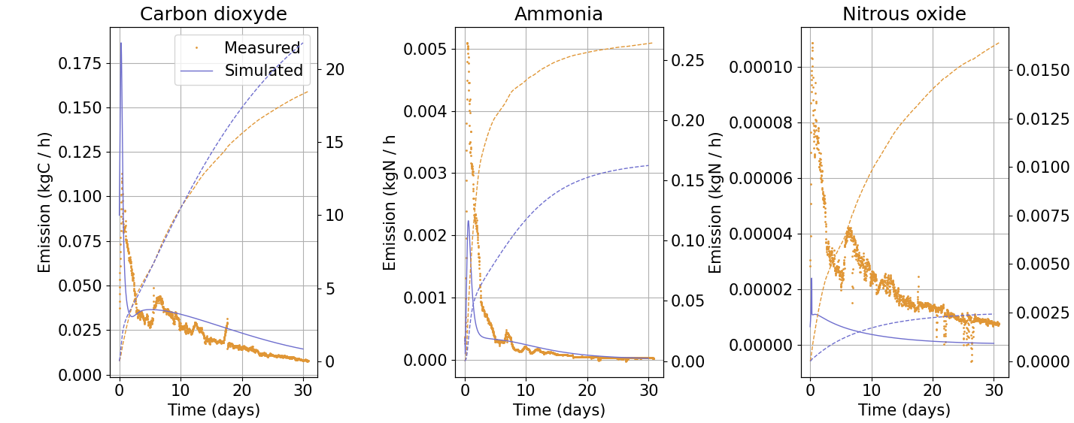
Generic composting model
Results
Carbon dioxide
Cumulated (kgC)
Hourly and cumulated emissions of generic model vs observation (Development)
(Robin et al. 2019)
Notes:
Does it work ?
Relults for a situation of the development dataset
HeapA

Slide 6
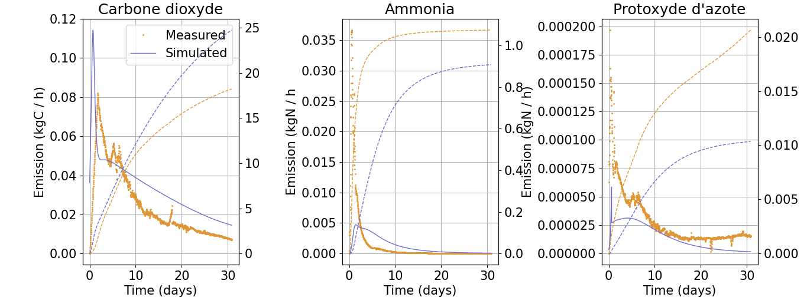
Generic composting model
Results
Carbon dioxide
Nitrous oxide
Cumulated (kgC)
Hourly and cumulated emissions of generic model vs observation (Validation)
(Robin et al. 2019)
Notes:
Does it work ?
Some of the original situations were kept aside for validation, and the model showed satisfactory results.
Heap C

Slide 7
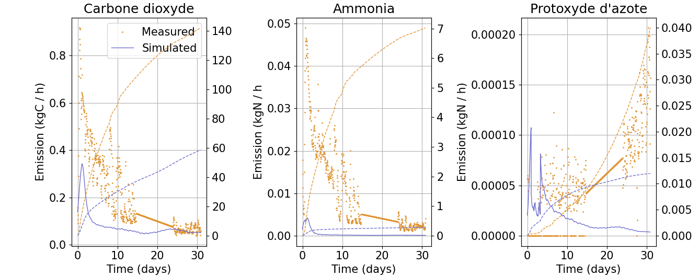
Generic composting model
Results
Carbon dioxide
Nitrous oxide
Cumulated (kgC)
Cumulated (kgC)
Cumulated (kgC)
Hourly and cumulated emissions of generic model vs observation (Tropical conditions)
(Robin et al. 2019)
Notes:
However, when tested with a different measurement setup, in a tropical region, and with a different mixture of wood chips and poultry litter, the model produced a wrong dynamic. We hypothesised that this could be related to the properties of the wood chips, but other phenomena or biases in the initialisation model could also explain the discrepancy.
Heap COF

Slide 8
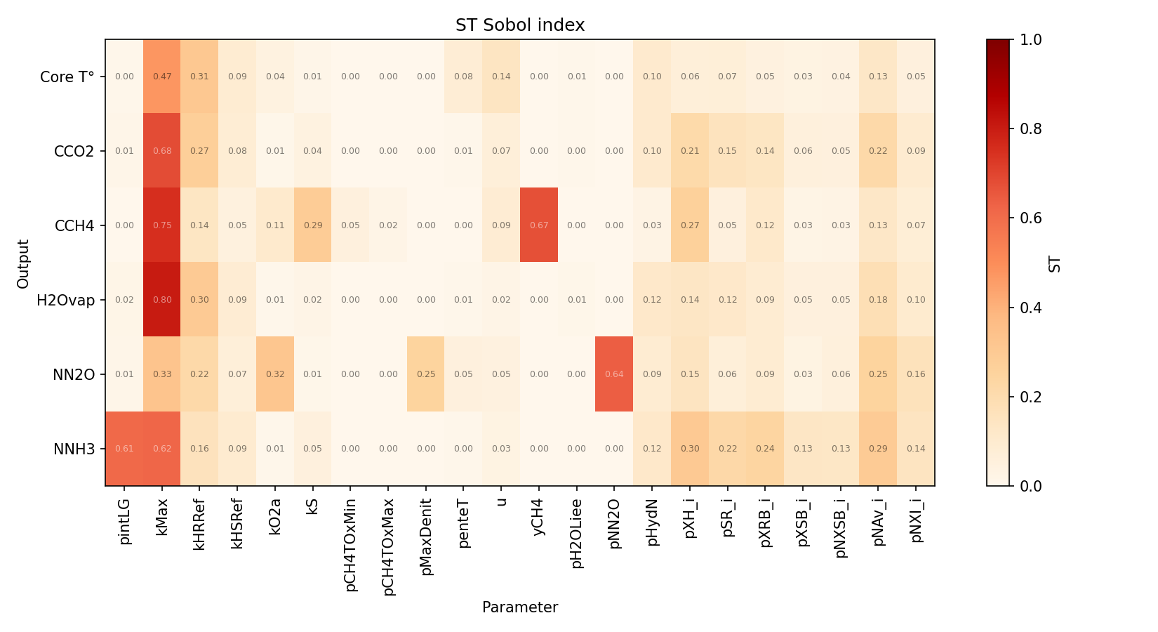
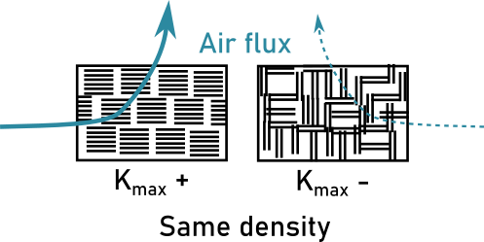
Generic composting model
How to improve it ?
kMax
Various distributions of macroporosity, free air space, connectivity
Sensibility (Sobol total indexes) of MEGASMOC relative to calibration parameters
→ Categorical approach ? (needs data)
(Sobol 1993)
Notes:
The calibration of the initialisation model is critical because it determines the value of highly influencial physical parameters. However, the linear regressions are limited because some of the physical parameters are not well represented by the observed measured properties. For example, Kmax is the permeability of the heap at it’s minimal density. It must be calibrated using measurable properties such as the gaseous losses of water or carbon. They can be simply deduced from dry matter analysis before and after the composting period. However, none of the quantitative measured properties can be conceptually linked to kmax. Categorical approach could be a way to handle parameters like Kmax. For now, we hardly have a handful of situation on the same type of effluent. But the categorical aproach would be fragile if based only on one or two case of each category so it needs a lot of data to achieve robust distributions of this parameter.​
​

Slide 9
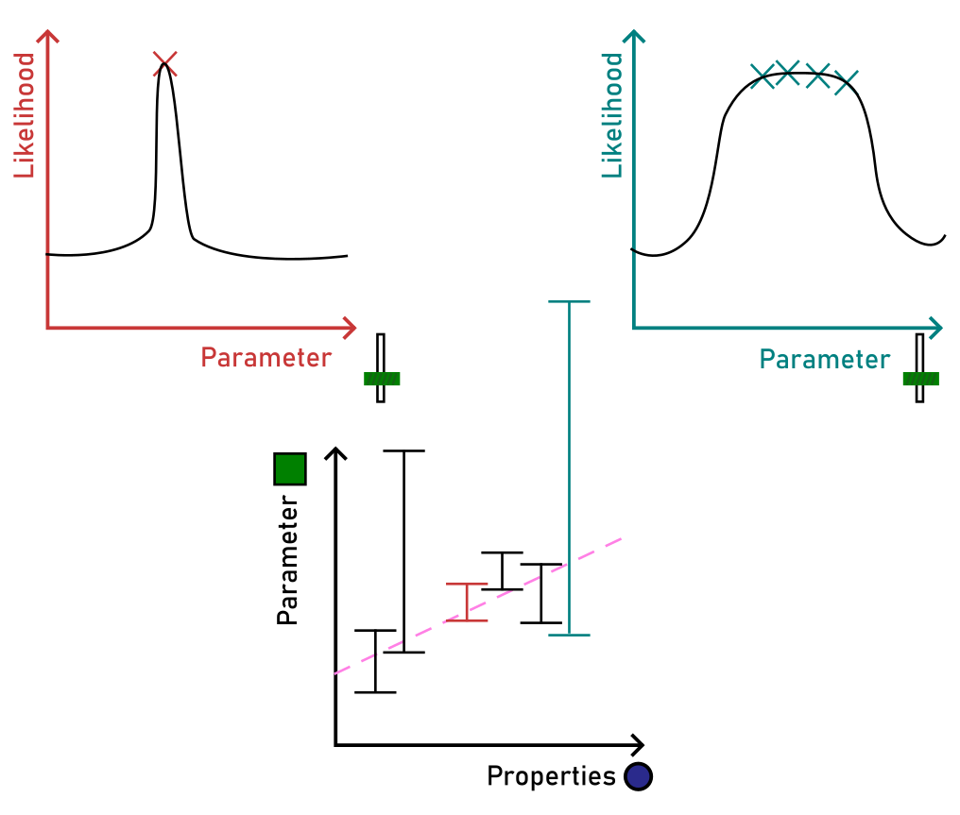
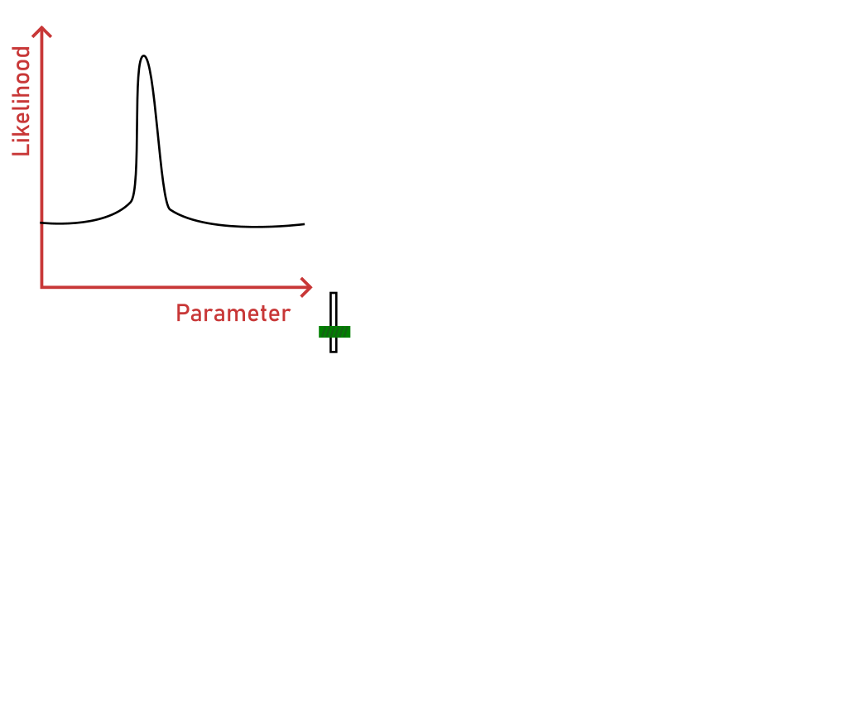
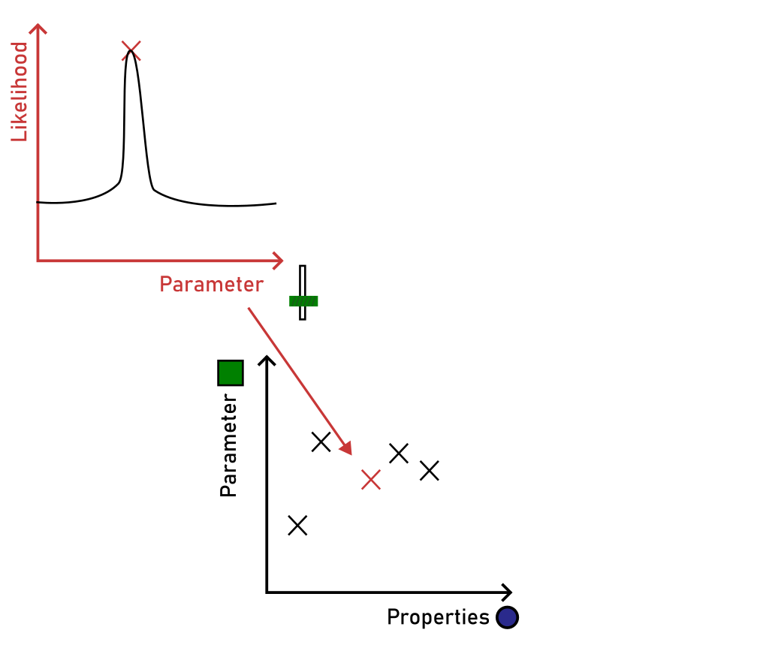
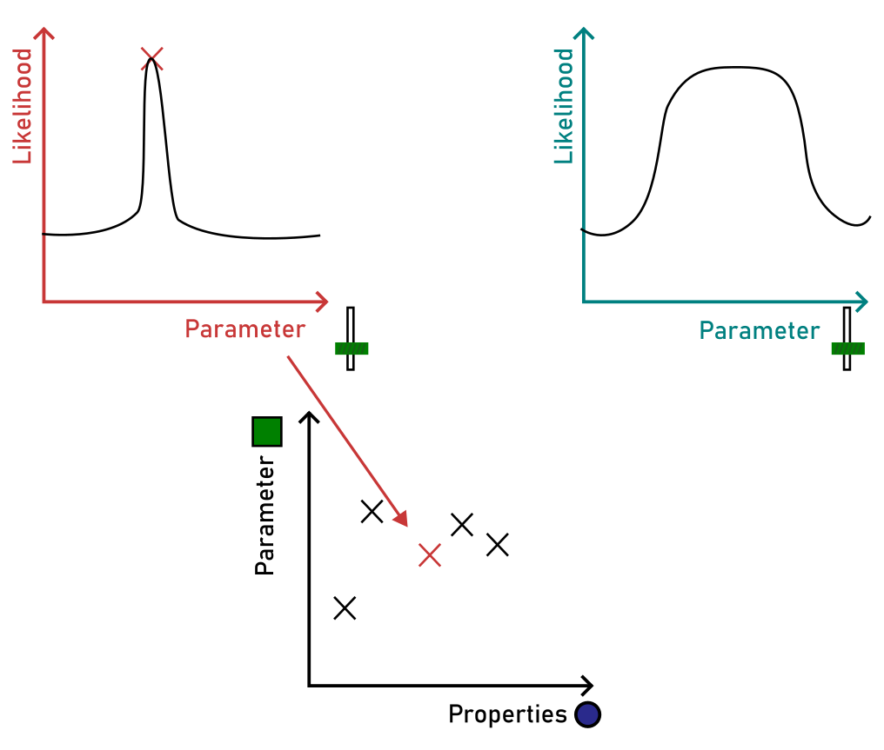
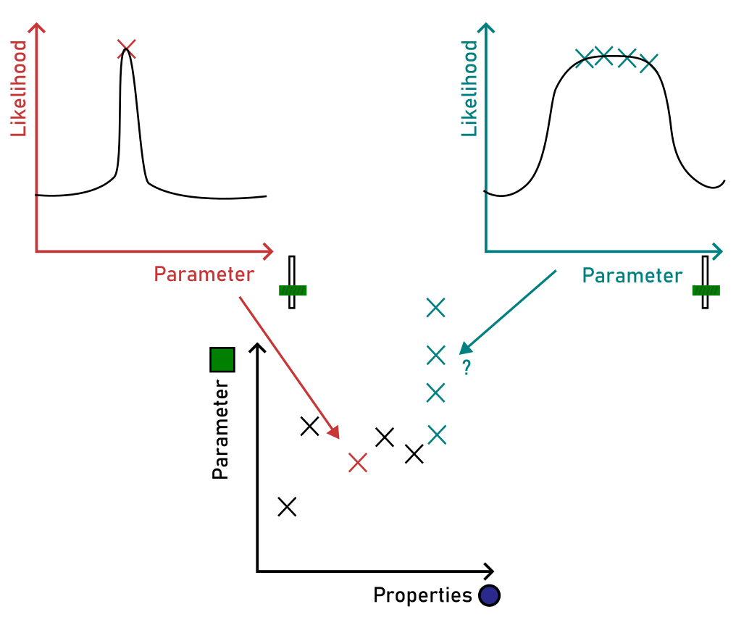
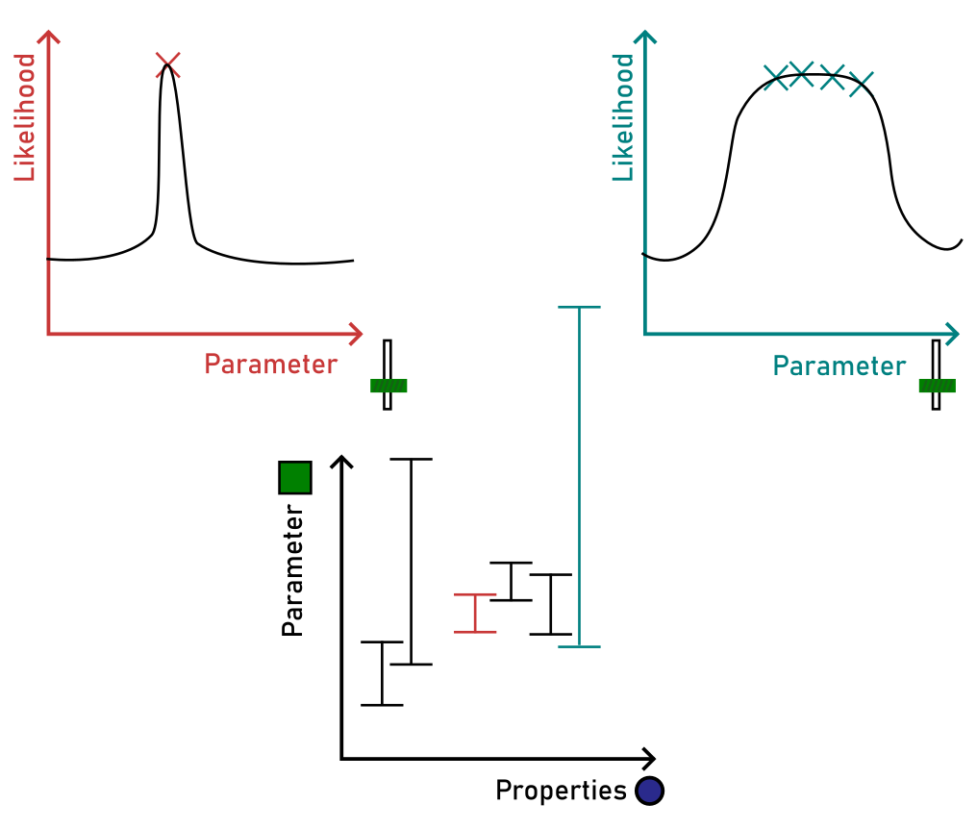
Genericity
How to improve it ?
→ Bayesian calibration
Notes:
Moreover, if we ever want to add or correct new phenomenons, we will need to trustfully repeat this calibration. However, the calibration we used is inconsistent due to smooth optimums.
Each parameter is calibrated by maximizing likelihood, the best likelihood is considered to be the best value of this parameter and we report it on the property/parameter graph so we can make the initialization model.
But if the likelihood curve is very smooth (or bimodal), we get a lot of realistic values. By choosing just the best value, we feed our initialization model with a point which may have a lot of influence whereas it shoudn’t because it’s just a possible values among others.
This is were we can mobilize Bayesian calibration: with Bayesian calibration, we give more importance to informative point.
You can think of it like adding intervals of possible values, now you can draw a model that cross all those interval, this is certainly different from what you get with only point (Bayesian calibration doesn’t work like this at all, but it take into account the plausible ranges of each situation)
It will also help differentiate uncertainty from parameters, from the mathematical implementation, and from the measure. ​

Slide 10
Part II: model coupling
For a given farm system, what is the impact of manure storage practices on greenhouse gas emissions and on solid manure stability?
→ A generic composting model
→ A way to transfer the outputs of the composting model into an existing soil–crop application/degradation model
→ A way to transfer the outputs of the composting model into an existing soil–crop application/degradation model
Notes:
Transition to 2nd part

Slide 11
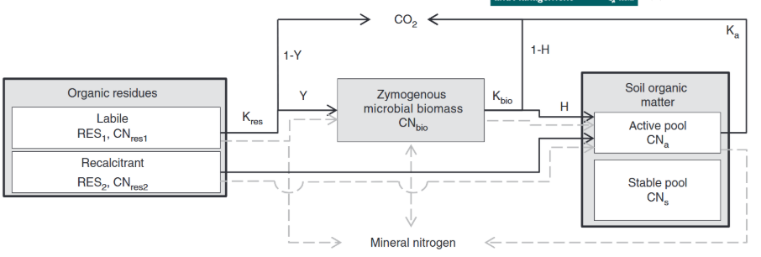
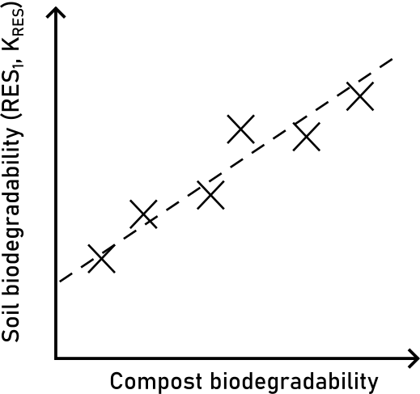
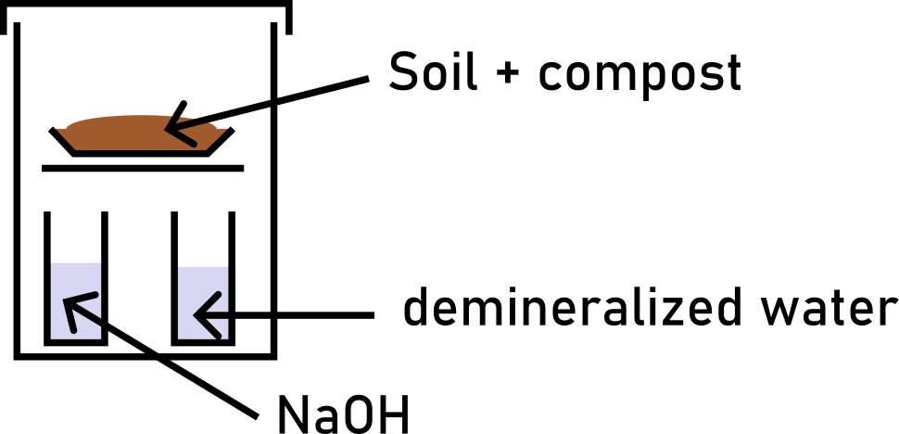
Model coupling
How to transfer the model outputs into an existing field emissions model ?
Is there a relation ?
Model of decomposition in soil (Levavasseur et. al., 2022)
Incubation (3 days + 90 days)
-Repartion parameter (RES₁)
-Speed parameter (K_{RES})
(Levavasseur et al. 2022)
Notes:
The behavior of added organic matter in the soil-crop system is described by Levavasseur (2022).​
It relies on 2 parameters, the fraction of labile organic matter (named RES1), the mineralisation rate of this fraction in the considered soil (named kRES).​
Levavasseur proposed equations to predict these parameters with 3 days incubations while reference values are based on 90 days incubations.​
We hypothesize that it may be a relation between the biodegredability, as represented by the composting model, and those biodegradability (in soil) parameters.
Therefore, we planned an experiment coupling composting, sampling organic mixture at different dates for incubation, followed by a crop trial. ​

Slide 12
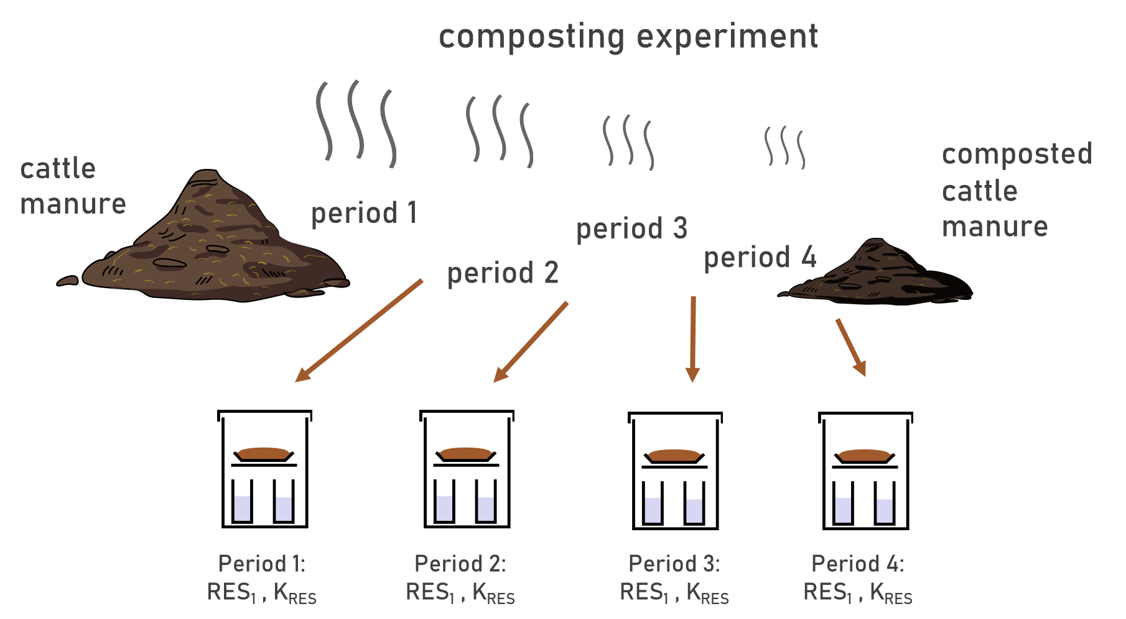
Model coupling
Future experiment
comparison with predicted gas emissions
comparison with predicted stability
Notes:
Experiment​
In order to acquire the corresponding dataset, we will conduct this winter an experiment featuring 4 types of manure. In order to account for the duration of storage, each manure will be sampled at three dates and at the end to perform an incubation with soil in laboratory condition. ​
These incubations will be use to calibrate the parameters of the decompostion model.​
In parallel, MEGASMOC will be ran on the 4 situations to determined the biodegrability at each date and compare the predicted emissions to the observed ones.​
The biodegradability values given by the composting model will be used to predict the parameters needed by the soil-crop model.​

Slide 13
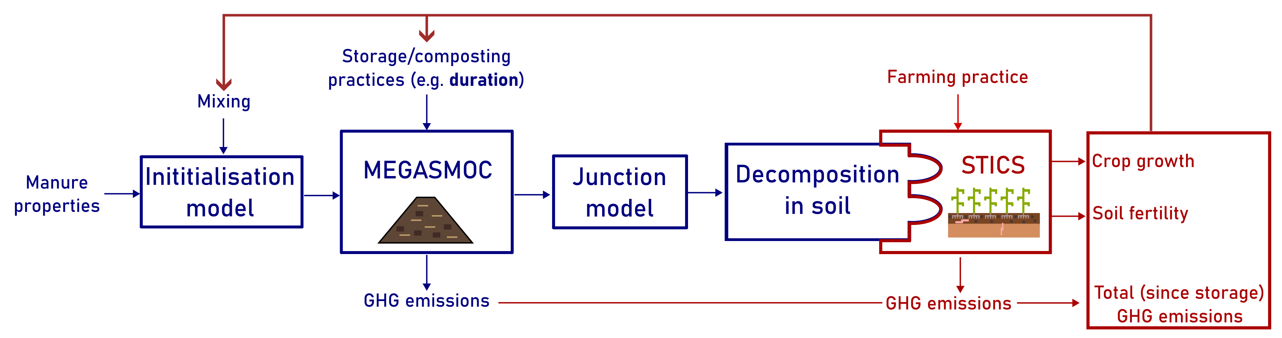
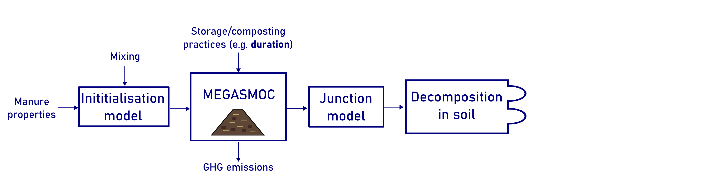
Model coupling
Perspectives
Scope of PhD
Notes:
What we aim to do with this PhD is reliably predict composting emissions, and the be able to represent degradation of the compost in soil. The model we used for soil is natively compatiple with the larger soil-crop model STICS. Prediction of uncertainties and low-cost methods to verify model predictions will also be proposed.​
As MEGASMOC and STICS both use a comprehensive approach to predict gaseous emissions, we will be able to predict effects on soil fertitlity and carbon storage. Other modules could be plugged ontop. ​This is the direct continuation of the PhD but a lot more work is needed to test, adapt and validate this part.
Ultimately, this would also allow inverse design : choosing compost practices and initial mix to meet the plant needs or maximise carbone storage.​

Slide 14
Thank you
for your attention
mailto: robin.pourcel@cirad.fr
References & slides

Slide 15
References
Chadwick, Dave, Sven Sommer, Rachel Thorman, et al. 2011. « Manure management: Implications for greenhouse gas emissions ». Animal Feed Science and Technology, Special Issue: Greenhouse Gases in Animal Agriculture - Finding a Balance between Food and Emissions, vol. 166‑167 (juin): 514‑31. https://doi.org/10.1016/j.anifeedsci.2011.04.036.
Levavasseur, Florent, Gwenaelle Lashermes, Bruno Mary, et al. 2022. « Quantifying and Simulating Carbon and Nitrogen Mineralization from Diverse Exogenous Organic Matters ». Soil Use and Management 38 (1): 411‑25. https://doi.org/10.1111/sum.12745.
Oudart, D., P. Robin, J. M. Paillat, et E. Paul. 2015. « Modelling nitrogen and carbon interactions in composting of animal manure in naturally aerated piles ». Waste Management 46 (décembre): 588‑98. https://doi.org/10.1016/j.wasman.2015.07.044.
Oudart, Didier. 2013. « Modélisation de la stabilisation de la matière organique et des émissions gazeuses au cours du compostage d’effluents d’élevage ». INSA de Toulouse.
Robin, Paul, Didier Oudart, Jean-Marie Paillat, et al. 2019. « MEGASMOC, modèle et base de données pour représenter les processus physiques et biologiques dans un « tas » de matière organiques ». Recherche Data Gouv, novembre 21. https://doi.org/10.15454/YAKUH6.
Sobol, I. M. 2001. « Global sensitivity indices for nonlinear mathematical models and their Monte Carlo estimates ». Mathematics and Computers in Simulation, The Second IMACS Seminar on Monte Carlo Methods, vol. 55 (1): 271‑80. https://doi.org/10.1016/S0378-4754(00)00270-6.

